Slide 1
Chapter 8 ICMPv4 and v6
ICMP
  Provides information about network connectivity and routing behavior
  Provides a way to return information to senders
  Messages are nothing more than specially formatted IP datagrams

Slide 2
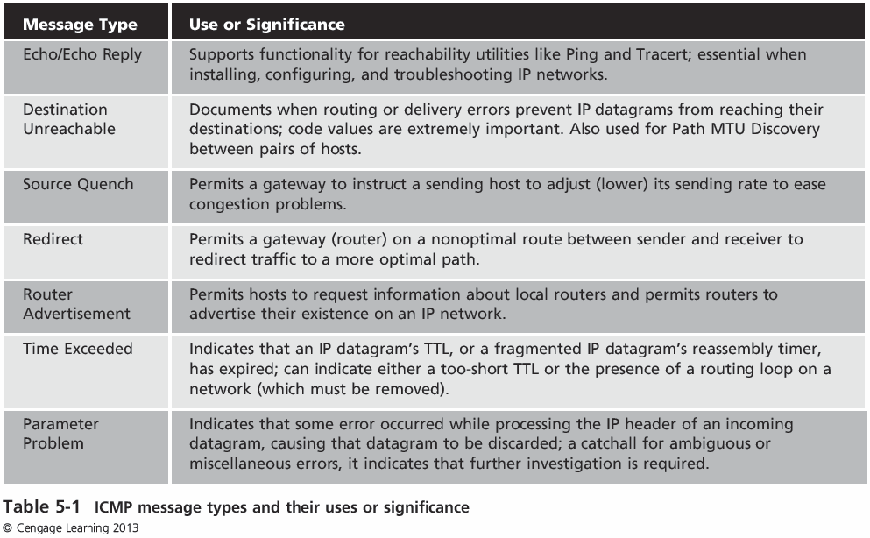
Chapter 8 ICMPv4 and v6

Slide 3
Chapter 8 ICMPv4 and v6
Core protocol in the IP suite
  Originally specified by RFC 777 (made obsolete by RFC 792)
ping command
  Widely used to test the connection between computers
Supports a series of network testing and error messages
  It carries no payload and is not used by computer applications

Slide 4
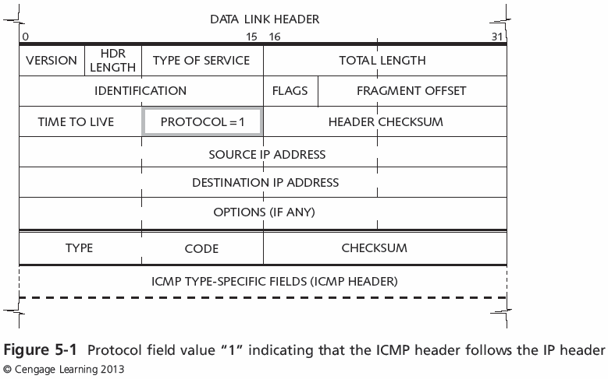
Chapter 8 ICMPv4 and v6

Slide 5
Chapter 8 ICMPv4 and v6
ICMP packets contain three required fields after the IP header
  Type
  Code
  Checksum
Type Field
  Identifies types of ICMP messages that can be sent on the network
  List is based on IANA documentation

Slide 6
Chapter 8 ICMPv4 and v6
  ICMPv4 have 2 general categories of messages
    Error messages
    Informal messages
Used for connectivity testing between network nodes
Ping utility
  Most common implementation of these messages

Slide 7
Chapter 8 ICMPv4 and v6
  Traceroute – similar to the ICMP Echo Request and Echo Reply messages
Traces the exact sequence of routers from source to destination
  On a hop-by-hop basis

Slide 8
Chapter 8 ICMPv4 and v6
ICMP Type 0
  Used for Echo Reply packets
ICMP Type 8
  Used for Echo Request packets
RFC 792
  Identifier and Sequence fields are used to aid in matching Echo messages with Echo Replies

Slide 9
Chapter 8 ICMPv4 and v6
  ICMPv6 provides the same basic mechanism for error reporting and information exchange between networked devices as ICMPv4
Type numbers 0–127 cover error messages
Type numbers 128–255 cover informational messages
Some message names are the same as their ICMPv4 counterparts
  But many of them are completely new

Slide 10
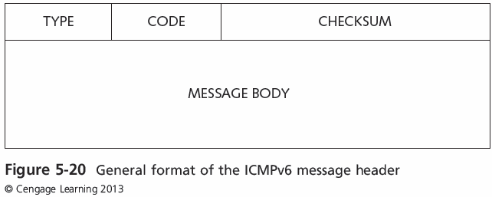
Chapter 8 ICMPv4 and v6
  ICMPv6 Header..(much smaller than a IPv4 Header?)

Slide 11
Chapter 8 ICMPv4 and v6
  Comparison of IPv4 and IPv6
Common general message types:
  Connectivity-checking messages
  Error-checking messages
  Informational messages
  Fragmentation required messages
ICMPv6 only general message types:
  Address Assignment messages
  Address Resolution messages
  Multicast Group Management messages
  Mobile IPv6 Support messages

Slide 12
Chapter 8 ICMPv4 and v6
ICMP’s most common uses are for testing and troubleshooting
Two well-known IP utilities
  Ping and Traceroute
  Rely on ICMP to perform connectivity tests and path discovery

Slide 13
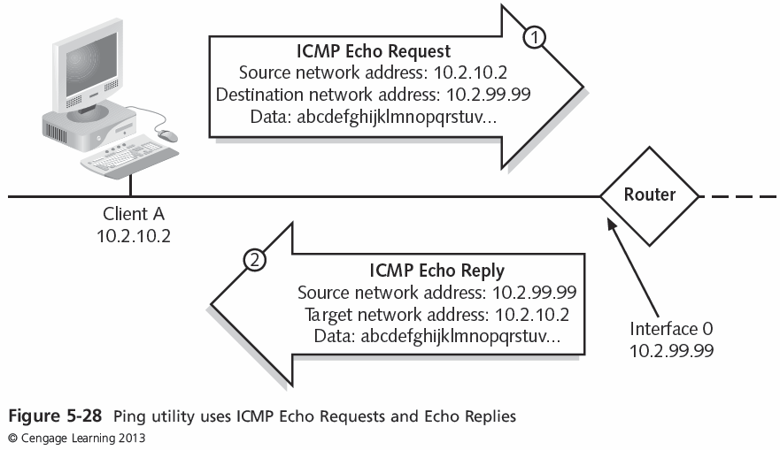
Chapter 8 ICMPv4 and v6

Slide 14
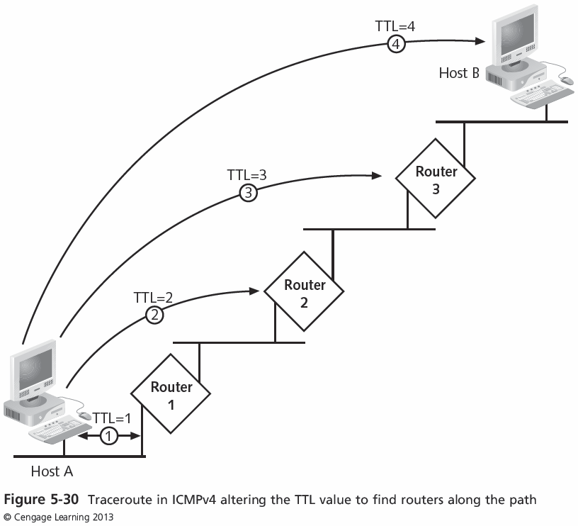
Chapter 8 ICMPv4 and v6
Introducing TCP/IP

Slide 15
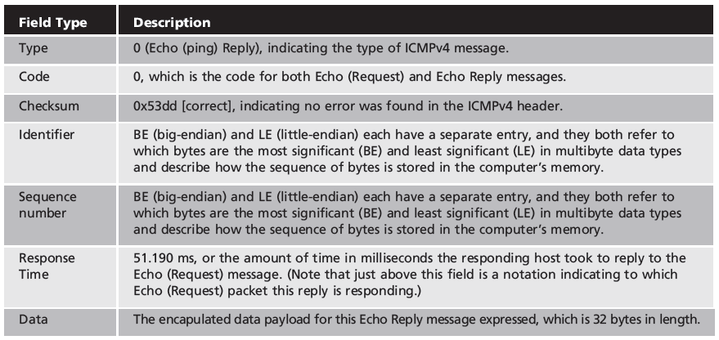
Chapter 8 ICMPv4 and v6
ICMPv4 Echo request and Echo reply message format types

Slide 16
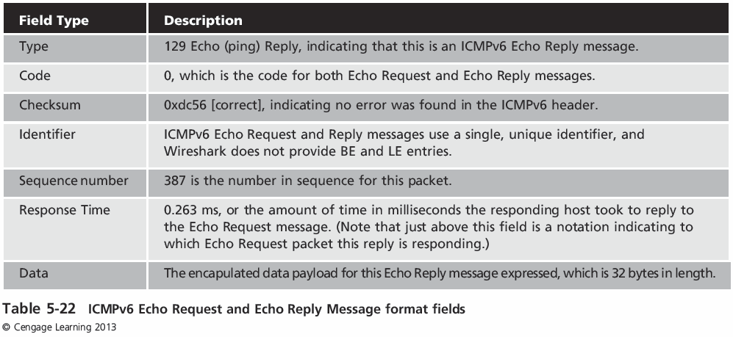
Chapter 8 ICMPv4 and v6
ICMPv6 Echo request and Echo reply message format types

